Slide 1

TIME SERIES FORECASTING OF CRYPTOCURRENCIES
Shivam Mishra
Prashanthi K
Jakob Cervenak
Notes:
Shivam:
Let’s see if we are able to live upto the expectations of creating a model that predicts Cryptos :P

Slide 2
CONTENTS
Problem Statement
Data Overview and Feature Curation
Data Exploration and Analysis - EDA
Machine Learning Model - Predictions
Summary
Notes:
Shivam:

Slide 3

Problem Statement
Fundamental task in financial modeling is predicting how prices will behave in the near future.
Cryptocurrency ‘returns’ prediction remains an open and extremely challenging forecasting task. This is a fascinating problem domain for the ML community given the extreme volatility of the assets, the non-stationary nature of the data, the market and meme manipulation, the correlation between assets and the very fast changing market conditions.
Notes:
Shivam:

Slide 4
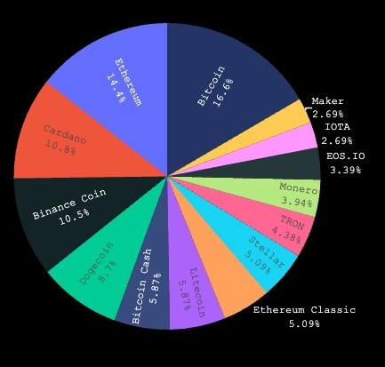
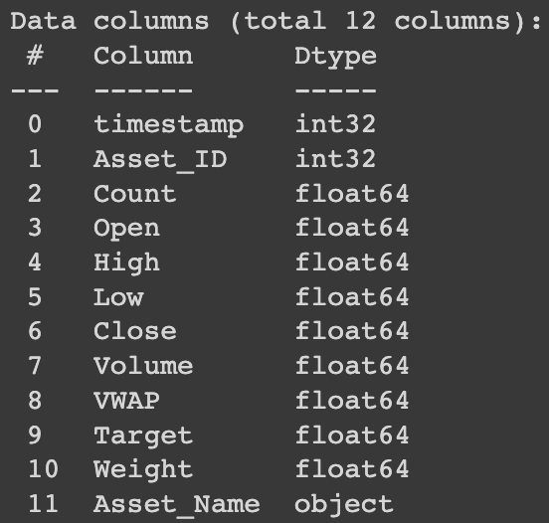
Data Overview and Feature CuratioN
Data Description
Data Processing
9 Features
2 Identifiers
1 Target Column
14 Cryptos
24,236,806 rows
Checked Missing or NA values
Target had Missing values
Forward filling gaps using .reindex method
Notes:
Shivam:
Only target column has missing data
Bitcoin has the least number of missing target values and Monero has the most.
There are no duplicate values in the dataset.
To fill the gaps, we used the .reindex()method for forward filling, filling gaps with the previous valid value.
eth = eth.reindex(range(eth.index[0],eth.index[-1]+60,60),method='pad')

Slide 5
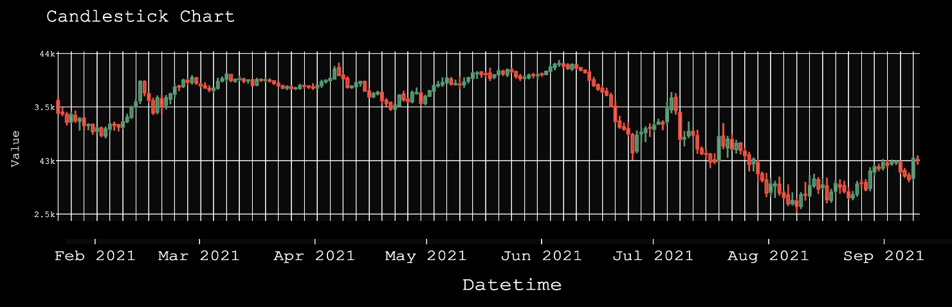
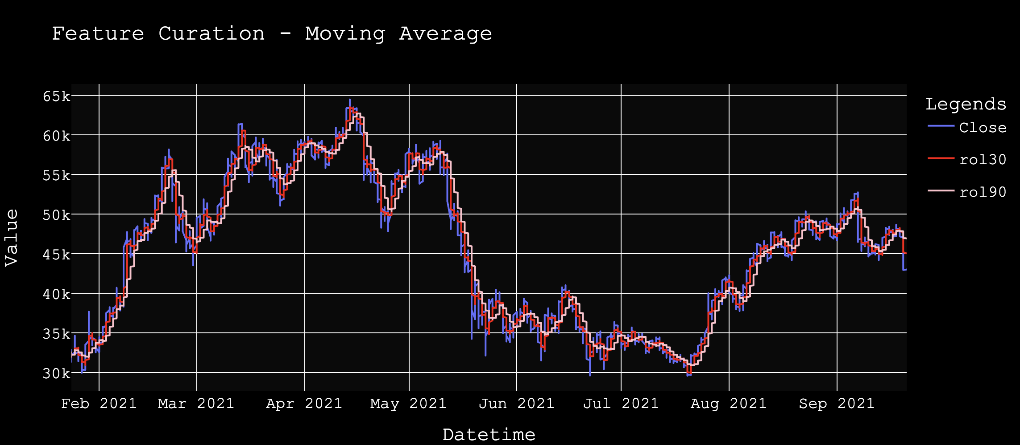
Data Overview and Feature CuratioN
Feature Curation
Feature Selection
Upper-Shadow and Lower-Shadow
Moving Averages for Open, Close, High, and Low
All features are important
High correlation between Open, Close, High, and Low features
Notes:
Shivam:
tmp_df["rol10"] = tmp_df['Close'].rolling(min_periods=0, window = 10).mean()
tmp_df["rol20"] = tmp_df['Close'].rolling(min_periods=0, window=20).mean()
tmp_df["rol30"] = tmp_df['Close'].rolling(min_periods=0, window=30).mean()
tmp_df["rol60"] = tmp_df['Close'].rolling(min_periods=0, window=60).mean()
tmp_df["rol90"] = tmp_df['Close'].rolling(min_periods=0, window=90).mean()
tmp_df["ewm10"] = tmp_df['Close'].ewm(span=10).mean()
tmp_df["ewm20"] = tmp_df['Close'].ewm(span=20).mean()
tmp_df["ewm30"] = tmp_df['Close'].ewm(span=30).mean()
tmp_df["ewm60"] = tmp_df['Close'].ewm(span=60).mean()
tmp_df["ewm90"] = tmp_df['Close'].ewm(span=90).mean()

Slide 6
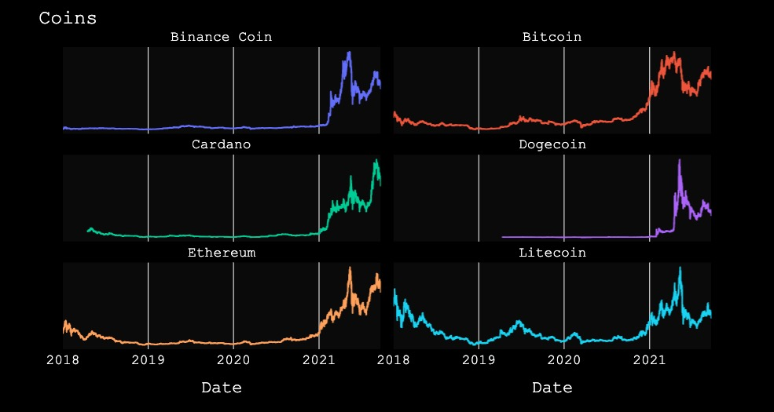
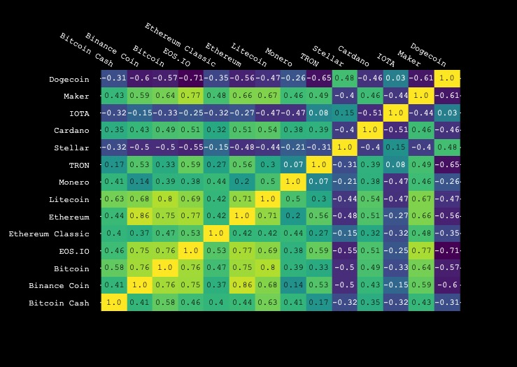
Data Exploration and Analysis - EDA
Correlation between cryptos
time series variations
Notes:
Shivam:
The assets have quite different history, but we could check if they correlate in recent times.

Slide 7
Machine Learning Model Predictions
Crypto can be complicated but predicting them is fun!

Slide 8


Machine learning framework
Predict VIA Stairstep
Predict VIA Traditional Train-Test
Predict the following week based on the Volume and Count values per hour of the the current week
Iterate a new xgboost regressor ‘weekly’
$R^{2}$ values mixed but successful for high trade coins
Bitcoin .95 and Ethereum .93
Showed slight trailing effect by nature of process
Standard train test split for data
Got rid of daily values for all but Volume and Count
Included rolling average , min, and max based on 6-months and year
Fair performance on pre-November 2020 ($R^{2}$ = .63)
Accuracy diminishes on late-2020 (starts to give a constant value)

Slide 9
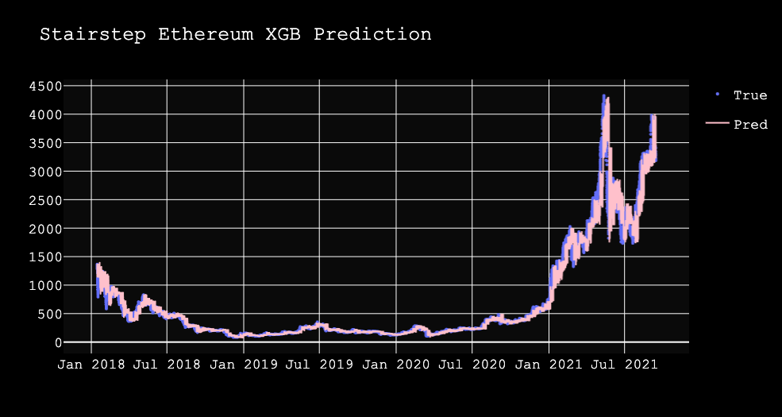
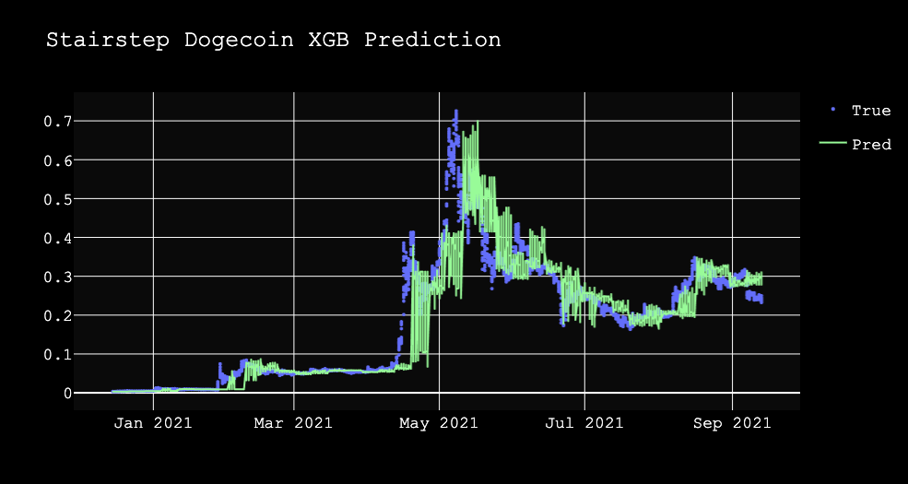
Machine learning framework
Predicting ‘close’ value - DogeCoin And Ethereum
R2 Value:
0.93
R2 Value:
0.79

Slide 10
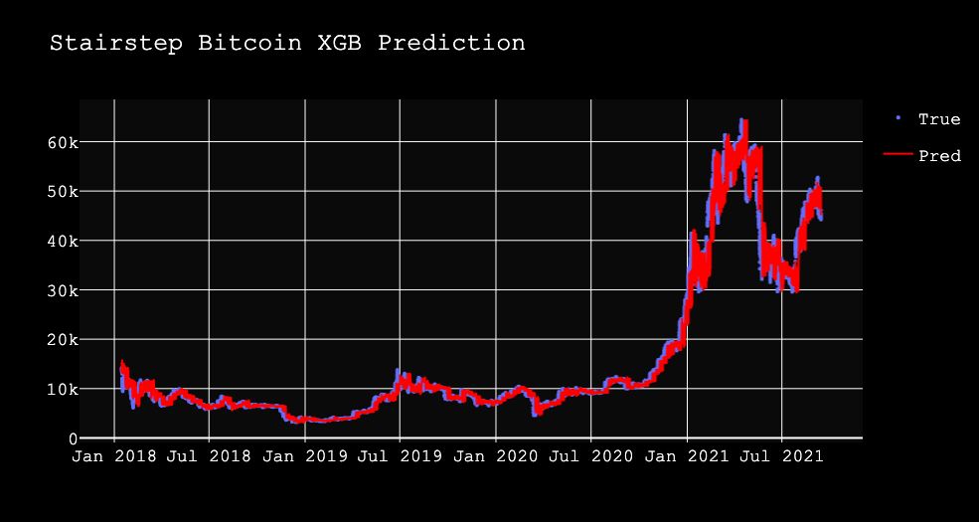
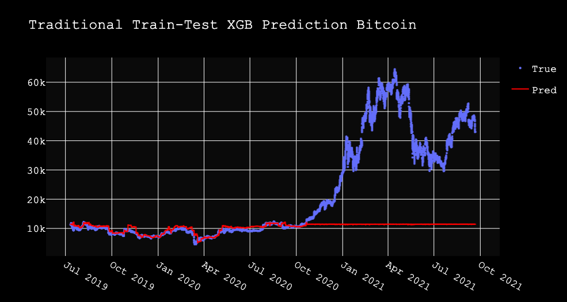
Machine learning framework
Predicting ‘close’ value Bitcoin
R2 Value:
0.95
R2 Value:
0.03

Slide 11
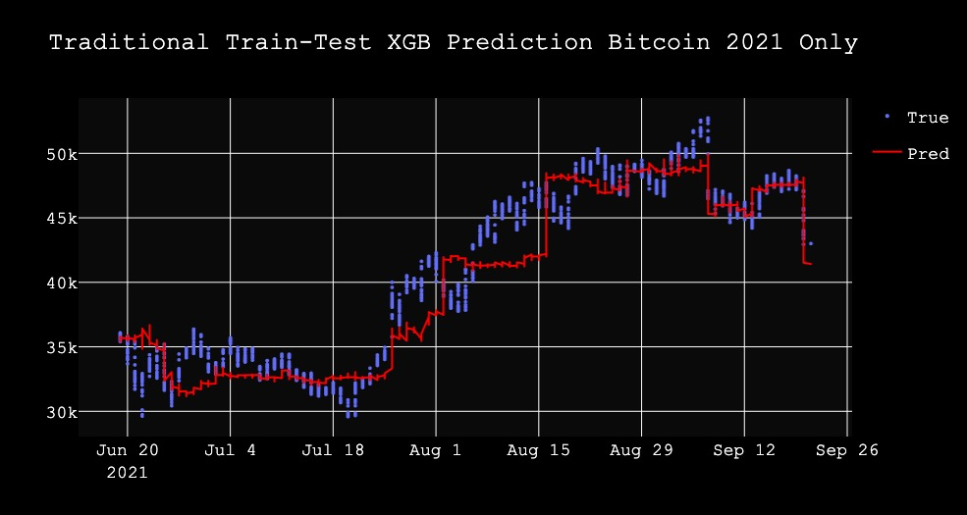
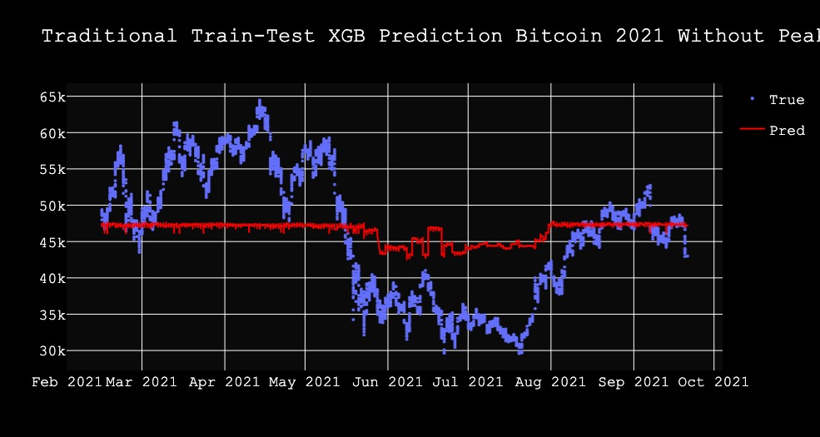
Machine learning framework
Predicting ‘close’ value Bitcoin
R2 Value:
0.88
R2 Value:
0.20

Slide 12
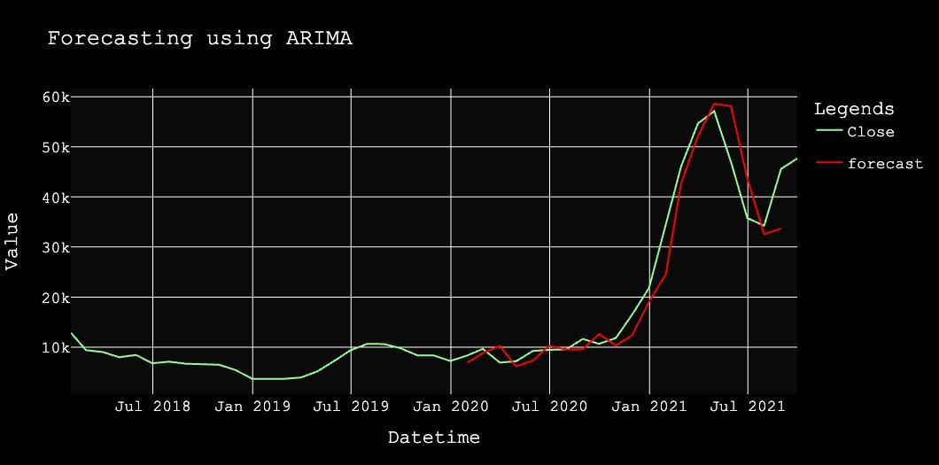
Machine learning framework
Predicting ‘close’ value
R2 Value:
0.9163

Slide 13
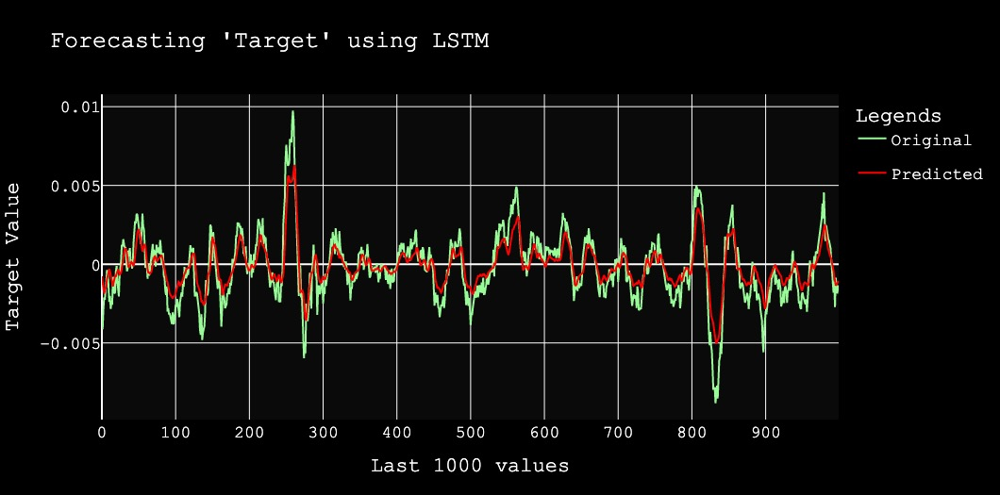
Machine learning framework
Predicting ‘Return’ value
R2 Value:
0.7965

Slide 14
SUMMARY
ARIMA works well on trends and adapts well to time-series, but XGB Regressor works best for specific daily fluctuations.
Increased volume and value changes makes accurate prediction more difficult

Slide 15
THANK YOU
Questions?

